Slide 1
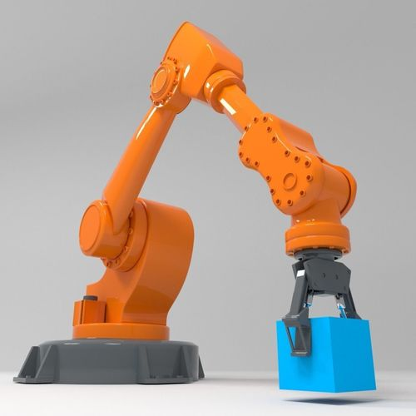
PICK AND PLACE ROBOT USING IMAGE PROCESSING FOR OBJECT DETECTION
GUIDE
DR. S. EWINS PON PUSHPA
TEAM MEMBERS
NAME REGISTER NUMBER EMAIL MOBILE NUMBER
1) Chris Jonathan Selwyn 2020105515 chrisjonathanselwyn@gmail.com 9003020695
2) Harish Raj S 2020105530 sharish29102002@gmail.com 7305920963
3) Benny Solomon S 2020105010 bennysolomonsam@gmail.com 8754497951
4) Kasini Venthan M 2020105540 kasiniventhan.2706@gmail.com 6382969581

Slide 2
OUTLINE
OBJECTIVE
REVIEW-1
REVIEW-2
POST REVIEW-2
RESULTS
CONCLUSION
REFERENCE

Slide 3
OBJECTIVE
The primary objective of the project is to design, construct, and implement a robotic system optimized for efficient object manipulation through advanced image processing techniques.
The aim is to seamlessly integrate mechanical, electronic, and software components to develop a versatile robot with the capability to identify and manipulate objects in its environment autonomously.
The project leverages the computational capabilities of Raspberry Pi for real-time image processing, allowing the robot to perceive and interpret its surroundings visually.
The project envisions a robotic system that, through the fusion of hardware and software components, can navigate its environment, recognize objects, and execute precise manipulations.

Slide 4
This project is driven by the synergy of Raspberry Pi's potent image processing capabilities and the precision control mechanisms offered by an raspberry-pi-based robotic arm.
This collaboration aims to create a robotic system with the cognitive ability to perceive its surroundings visually and the physical prowess to autonomously manipulate objects within that environment.
The significance of this project lies in its potential to redefine automation. The robot's ability to autonomously identify, interpret, and manipulate objects aligns with the broader shift towards intelligent automation across various industries.

Slide 5
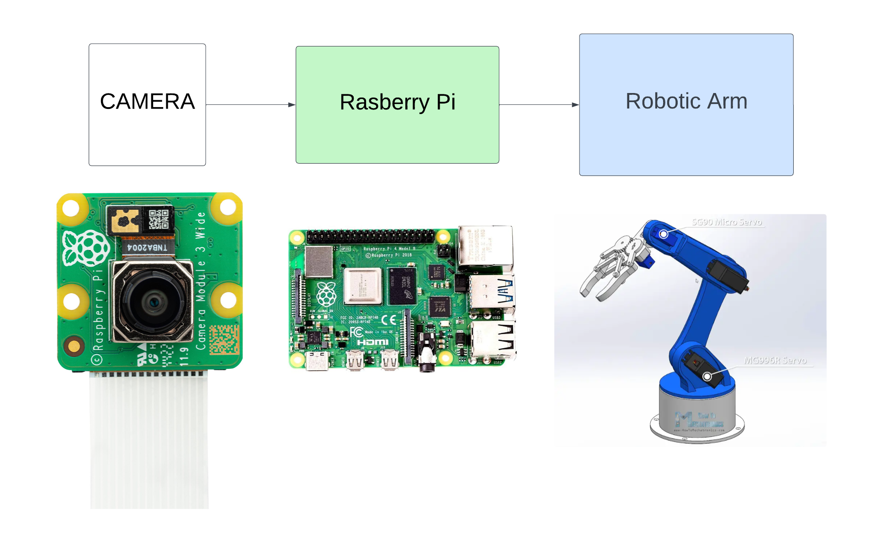
BLOCK DIAGRAM

Slide 6
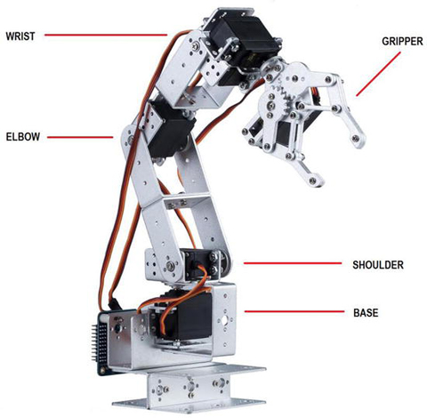
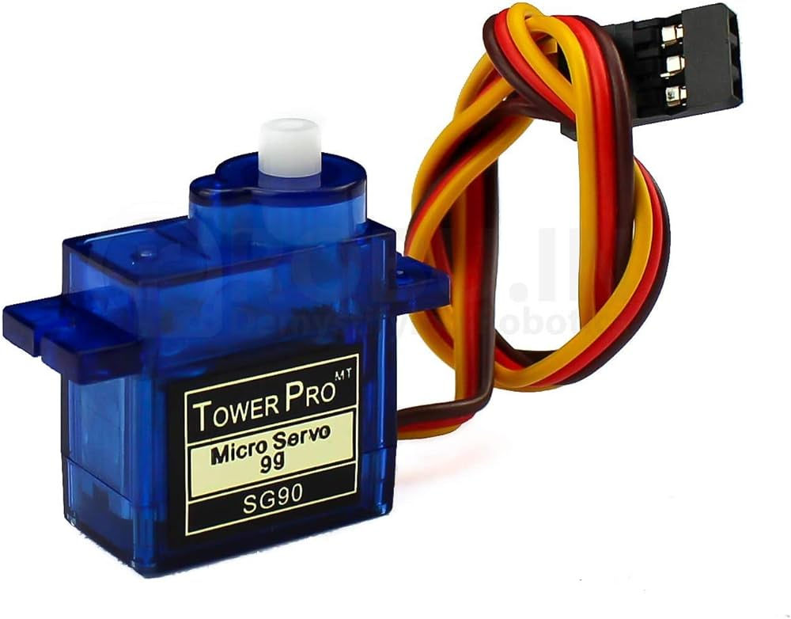
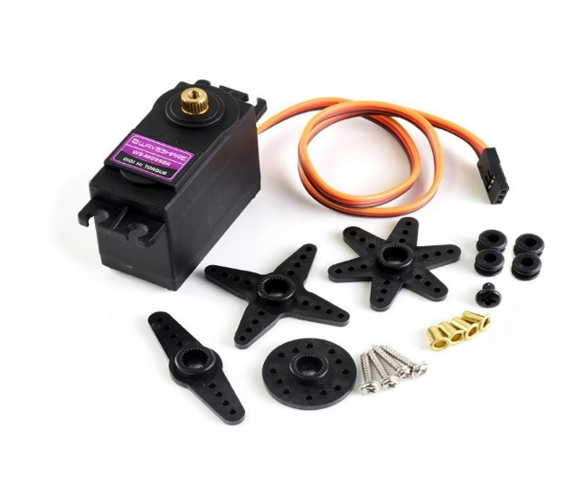
ROBOTIC ARM
SG90 Micro Servo
MG996R Servo

Slide 7
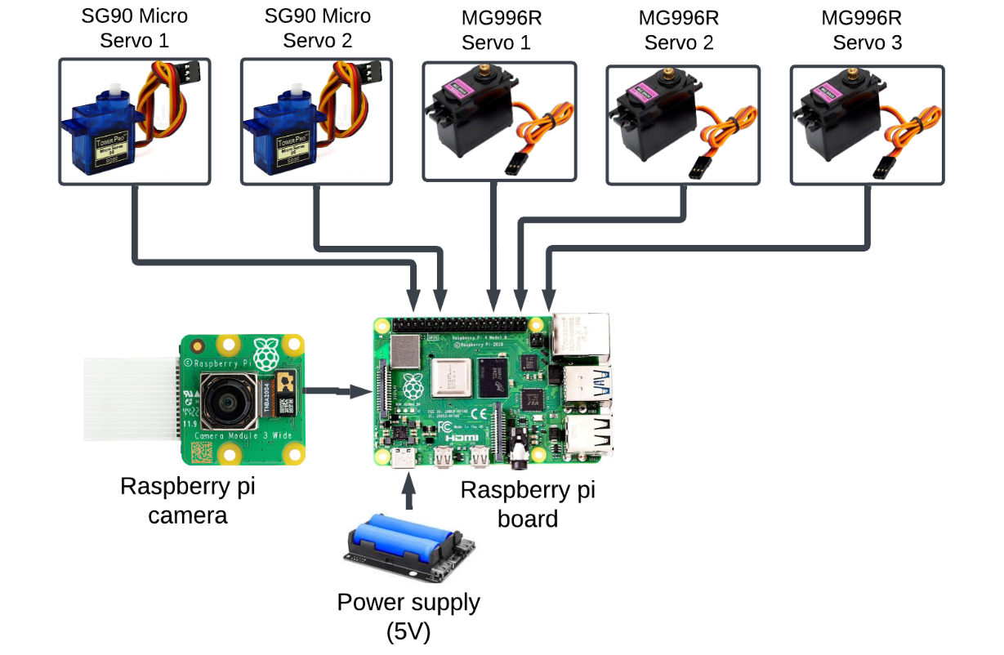
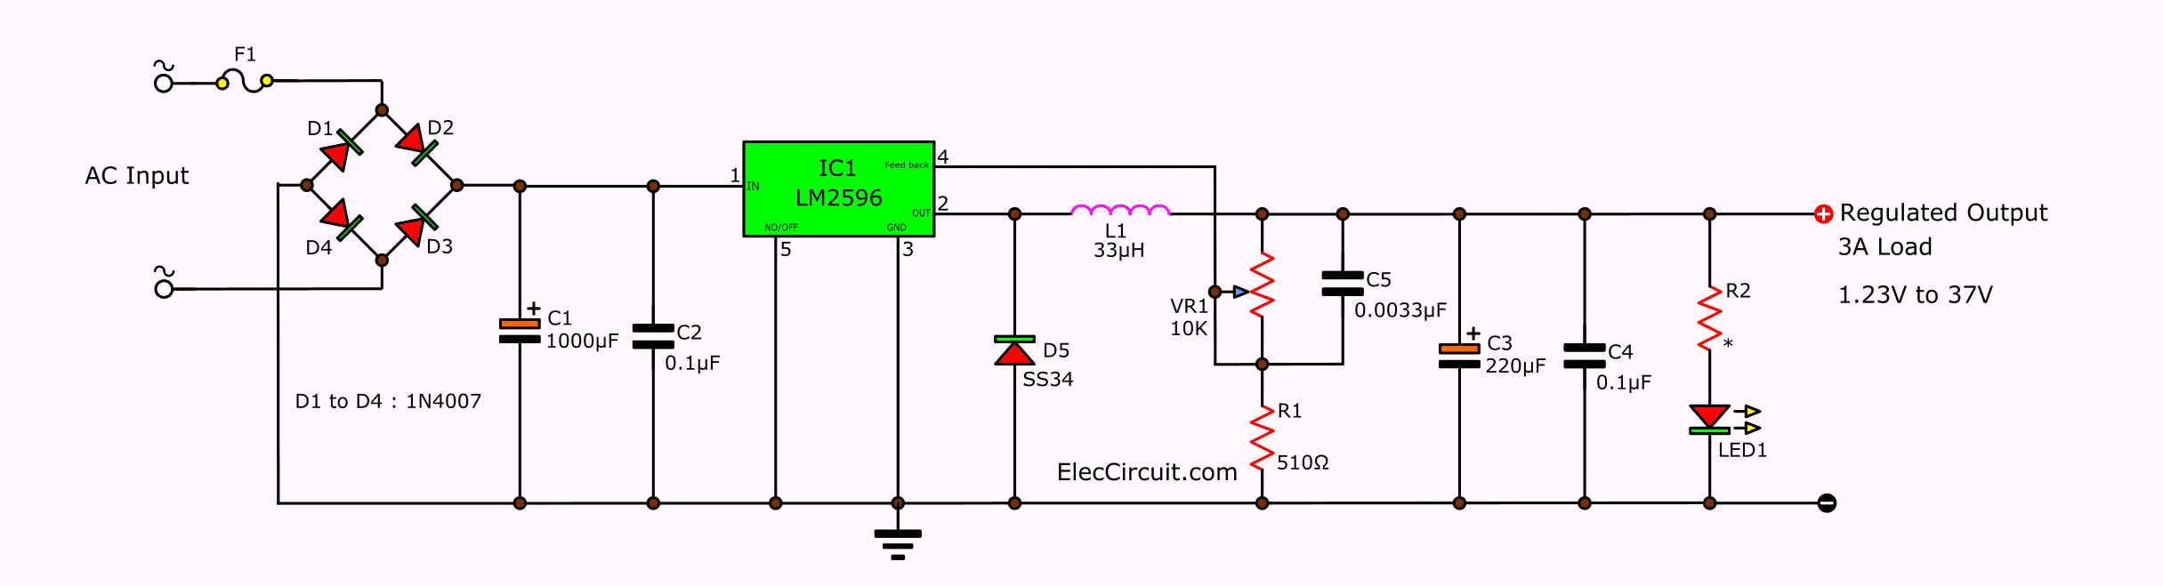
ROBOTIC ARM
LM2596 circuit voltage regulator

Slide 8
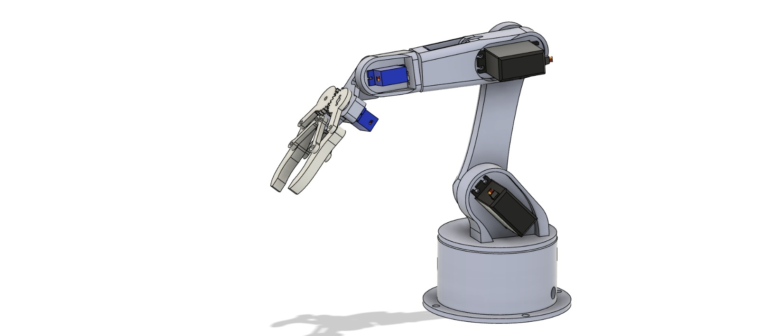
ROBOTIC ARM

Slide 9
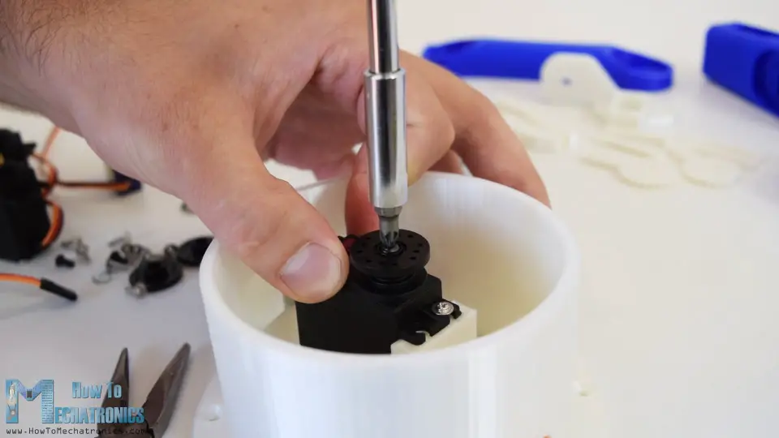
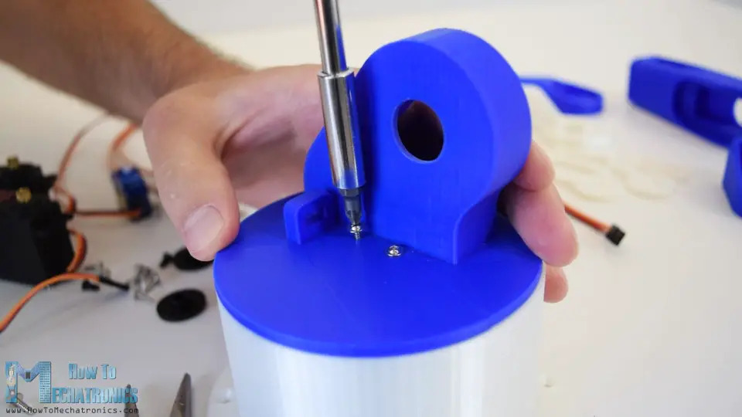
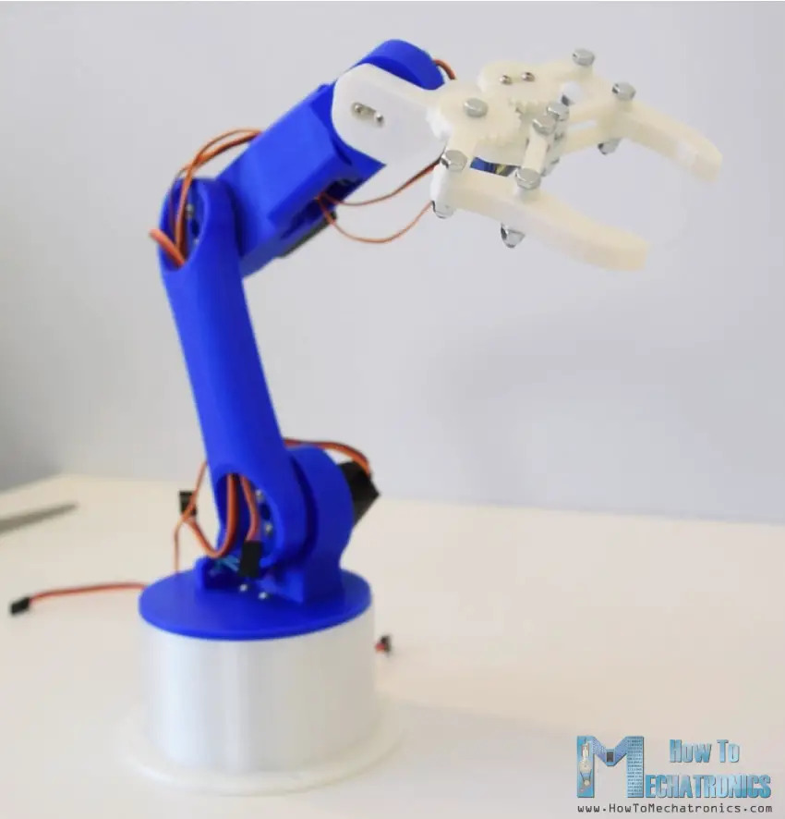
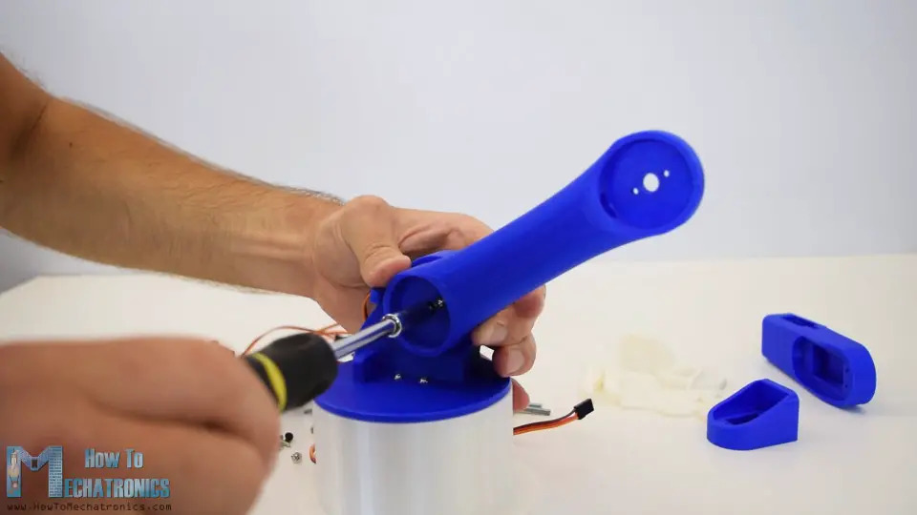
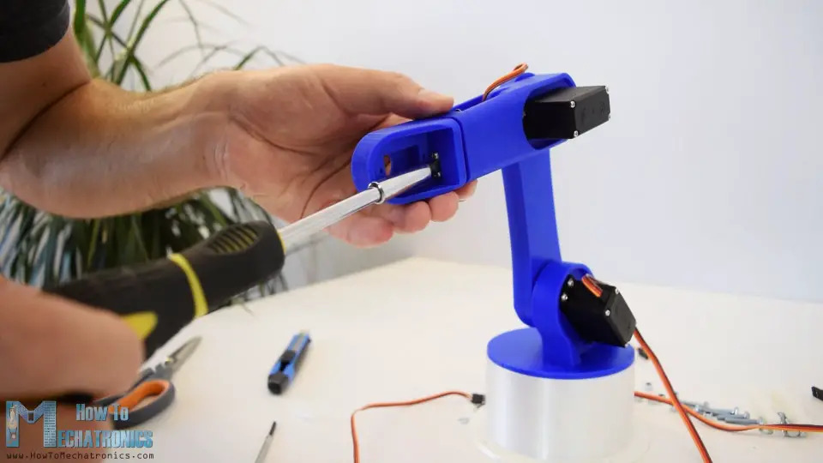
REVIEW 1- FUSION360 ROBOTIC ARM DESIGN & 3D PRINT
Assembling the Robotic Arm: Attach the first servo to the base with included screws. Secure a round horn with a bolt on the servo's output shaft. Add upper part, securing with two screws. Include a spring or rubber band for support. Continue assembling using bolts and nuts for the gripper mechanism. Complete the 3D Printer Robot Arm by attaching the gripper to the last servo.

Slide 10
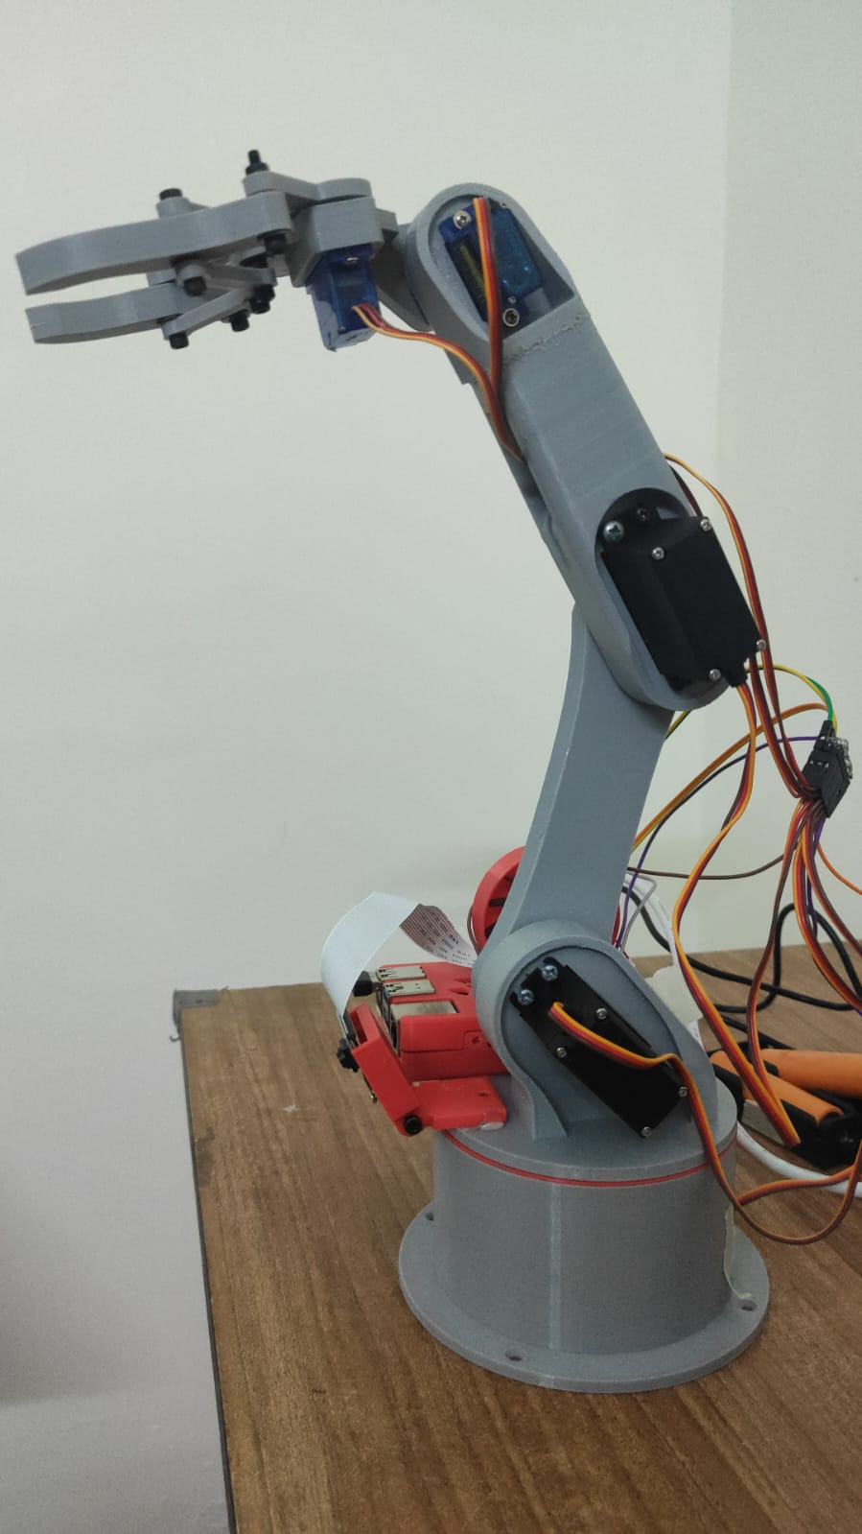
ROBOTIC ARM – 3D PRINTED

Slide 11
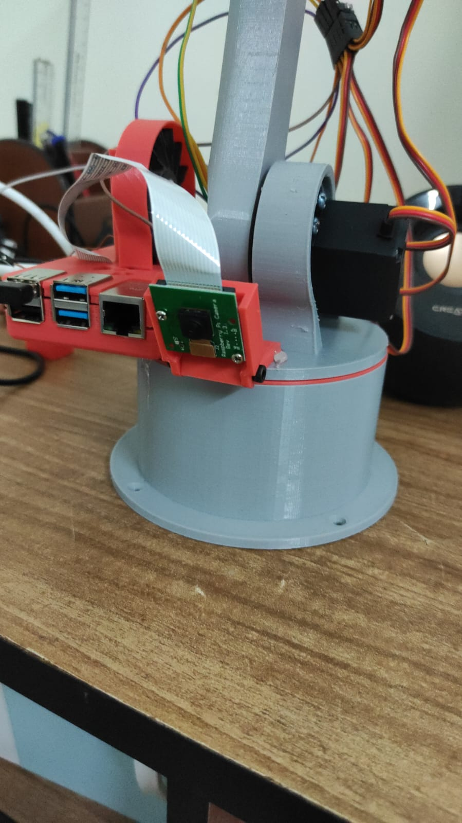
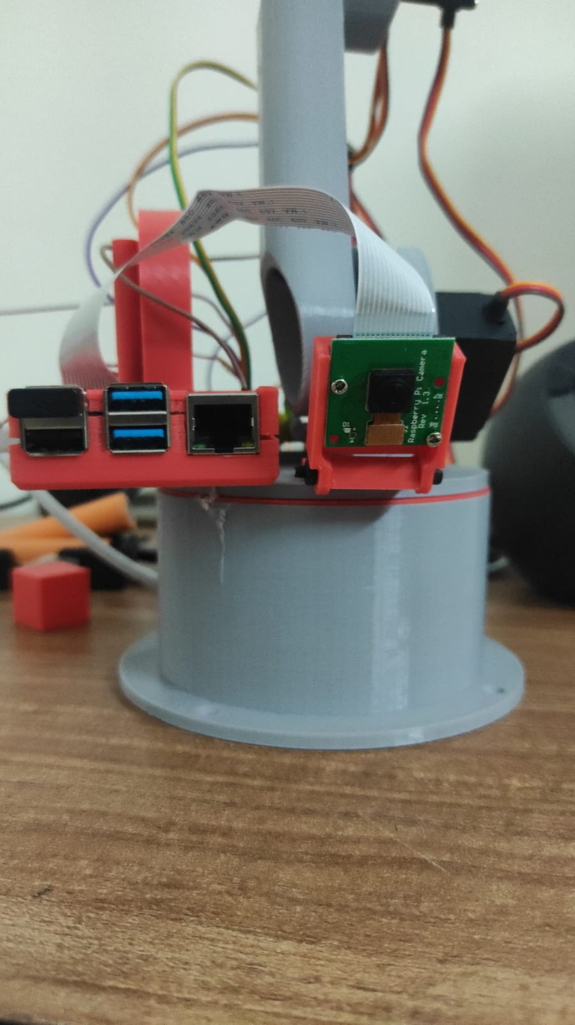
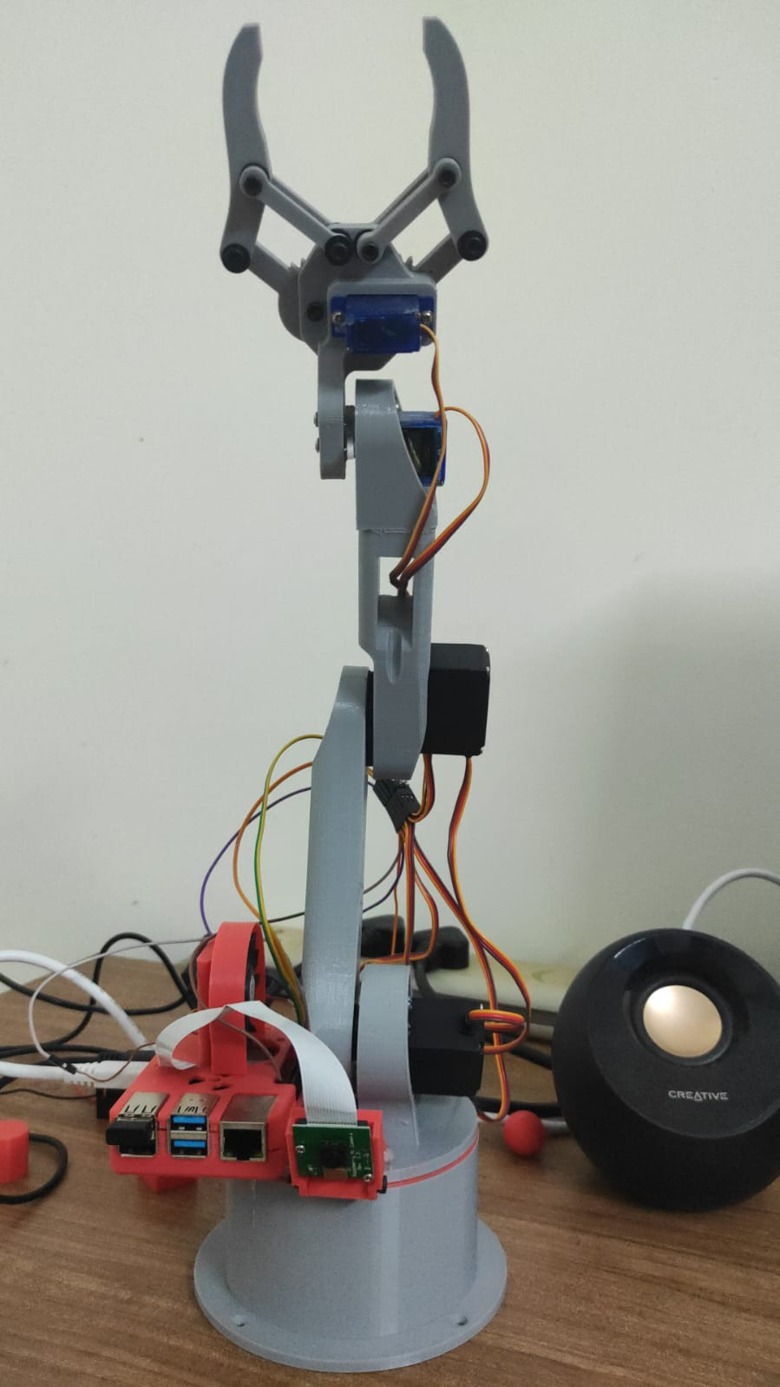
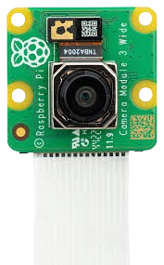
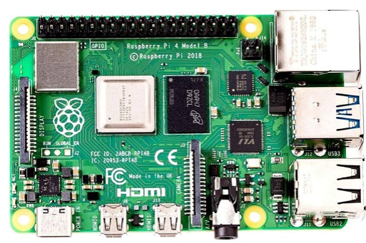
REVIEW 2 – INTEGRATING RASPBERRY PI WITH THE ARM
Raspberry pi camera
Raspberry pi
Board

Slide 12

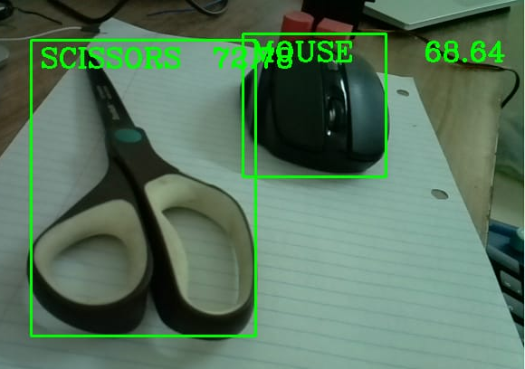
IMAGE PROCESSING
Used SSD MobileNetV3, pre-trained on COCO. The getObjects function detects objects, returning class IDs, confidence scores, and bounding box coordinates.
getObjects allows adjusting detection (thres) and NMS thresholds to refine sensitivity and accuracy. NMS removes overlapping boxes based on the threshold.
Captures webcam frames, detects objects with getObjects, and labels them with bounding boxes, class names, and confidence scores. Suitable for surveillance, robotics, and smart environments.

Slide 13
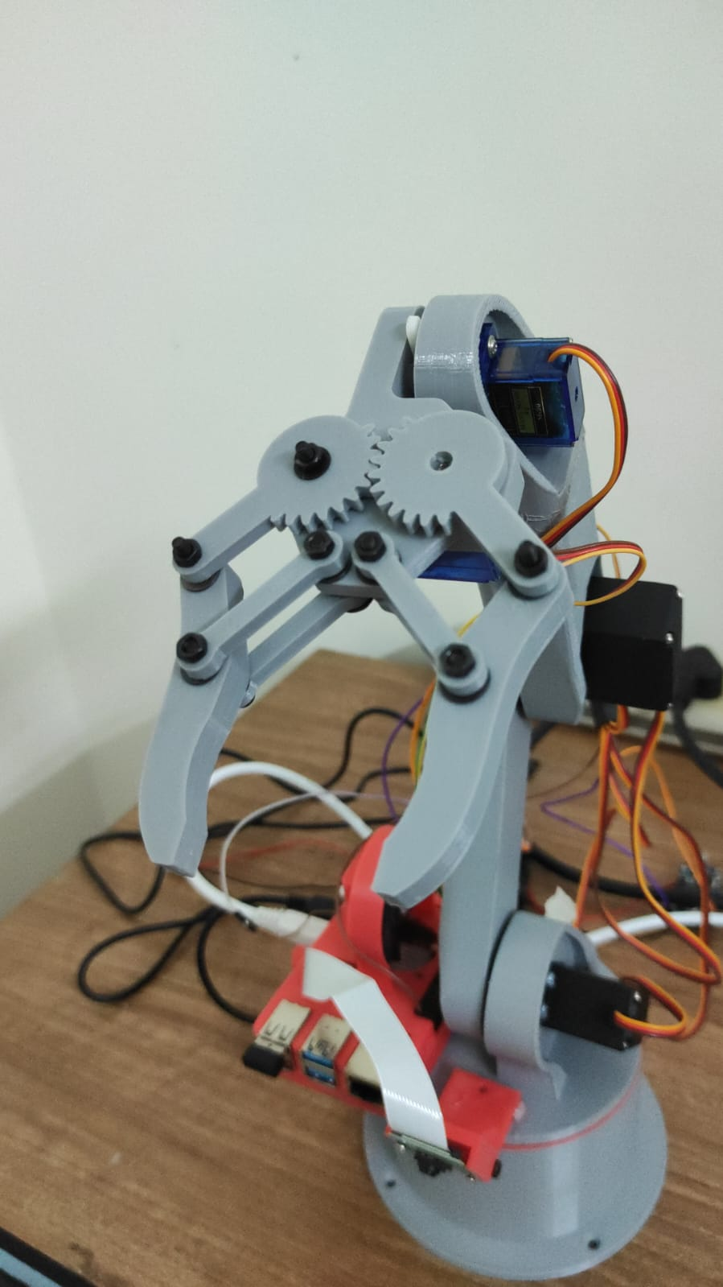
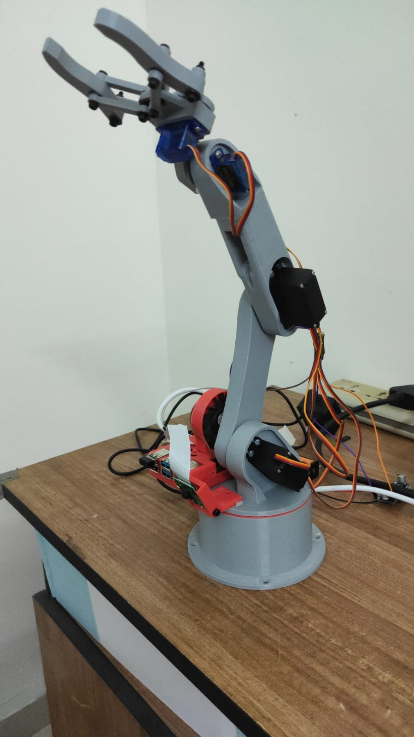
POST REVIEW 2 - AUTOMATION OF ARM TO DETECT AND PLACE OBJECT

Slide 14
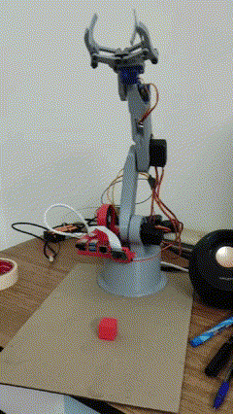
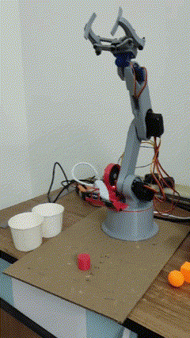
RESULTS

Slide 15
REFERENCES
https://core-electronics.com.au/guides/raspberry-pi/object-identify-raspberry-pi/
https://howtomechatronics.com/tutorials/arduino/diy-arduino-robot-arm-with-smartphone-control/
https://www.universal-robots.com/in/blog/robotic-arm/
https://mmla.gse.harvard.edu/tools/coco-ssd-object-detector/#:~:text=The%20pre%2Dtrained%20COCO%2DSSD,the%20model%20was%20trained%20on

